Slide 1

<Date>, <Name>
Notes:
Hello everyone!
We are happy to be here again this year at the Black Forest Hackathon.

Slide 2

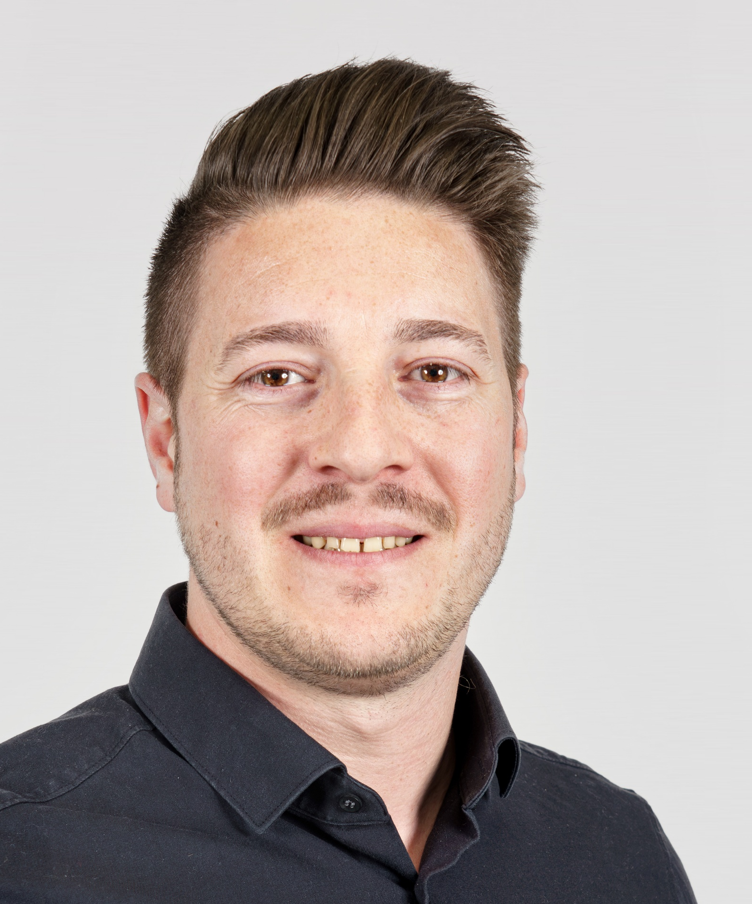

Hackathon Supporter
Jan Müllerleile
Adin Özder
Implementation Consultant CAD
Domain Transformation Manager
Jan.muellerleile@bct-technology.com
Adin.Oezder@bct-technology.com
+49 160 6823173
+49 171 5380428
Notes:
My name is Adin Özder, and I work in Sales at BCT.

Slide 3


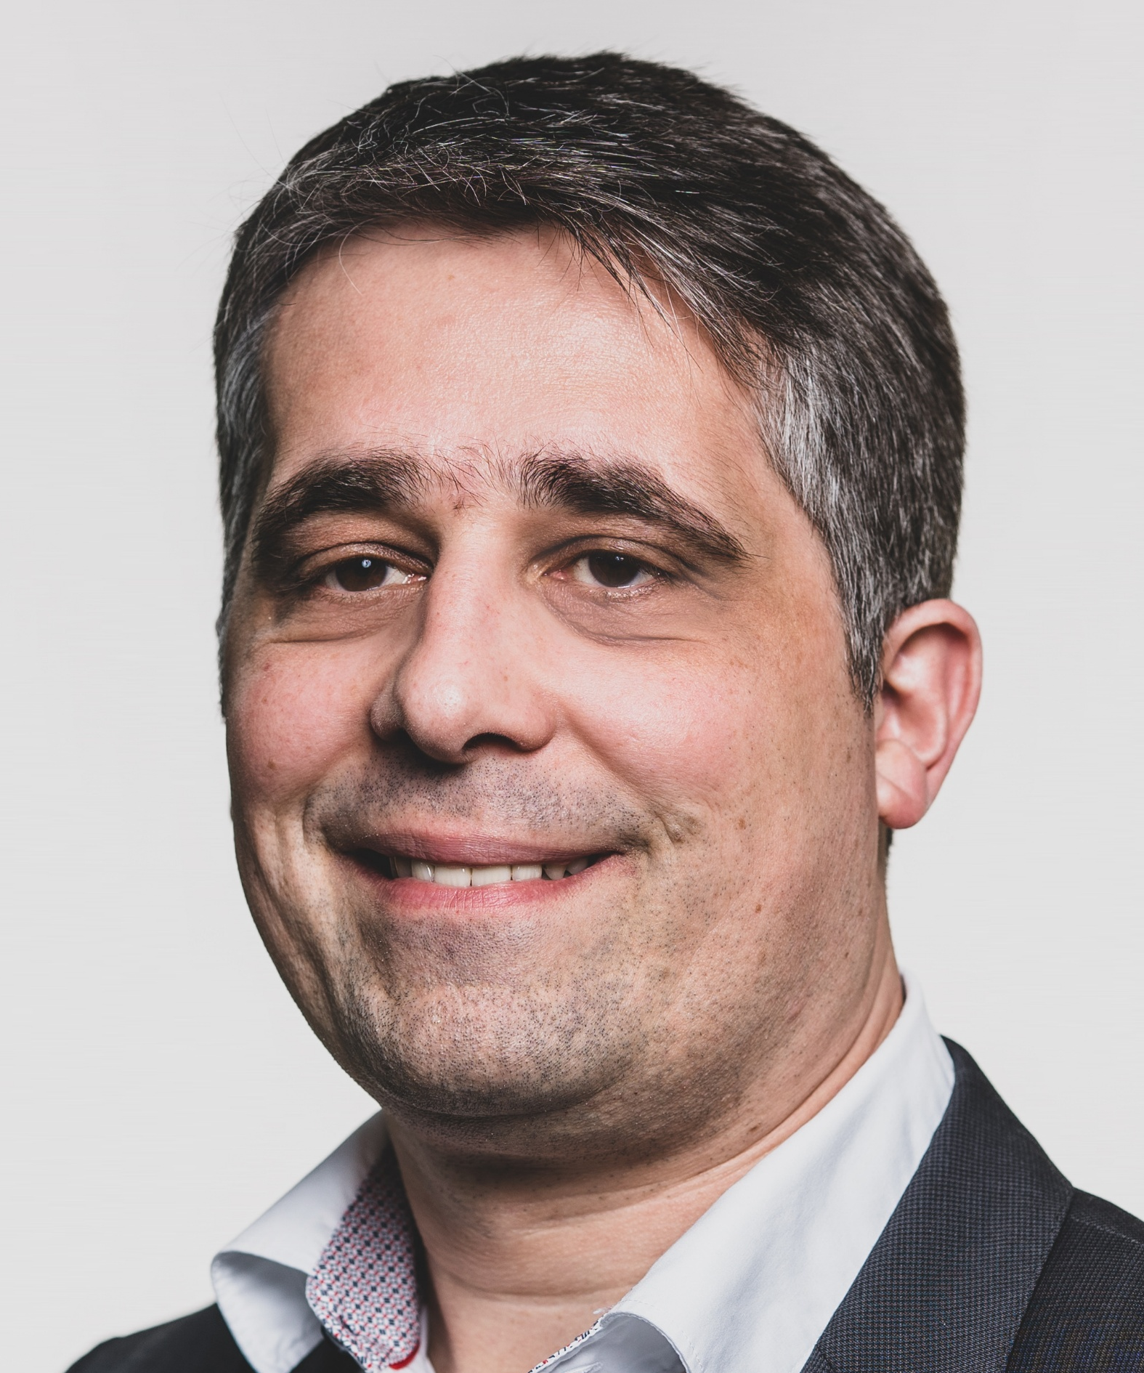
Hackathon Supporter
Jannik Schüle
Sascha Ellmer
Marko Weber
Associate AI Consultant
Leiter Auftrags- & Projektabwicklung, Prokurist
Head of Product Development
Jannik.Schuele@bct-technology.com
sascha.ellmer@bct-technology.com
Marko.Weber@bct-technology.com
+49 151 592 312 12
+49 173 922 9612
+49 162 965 3660
Notes:
These are our other colleagues.
If you have any questions, feel free to ask us anytime.

Slide 4
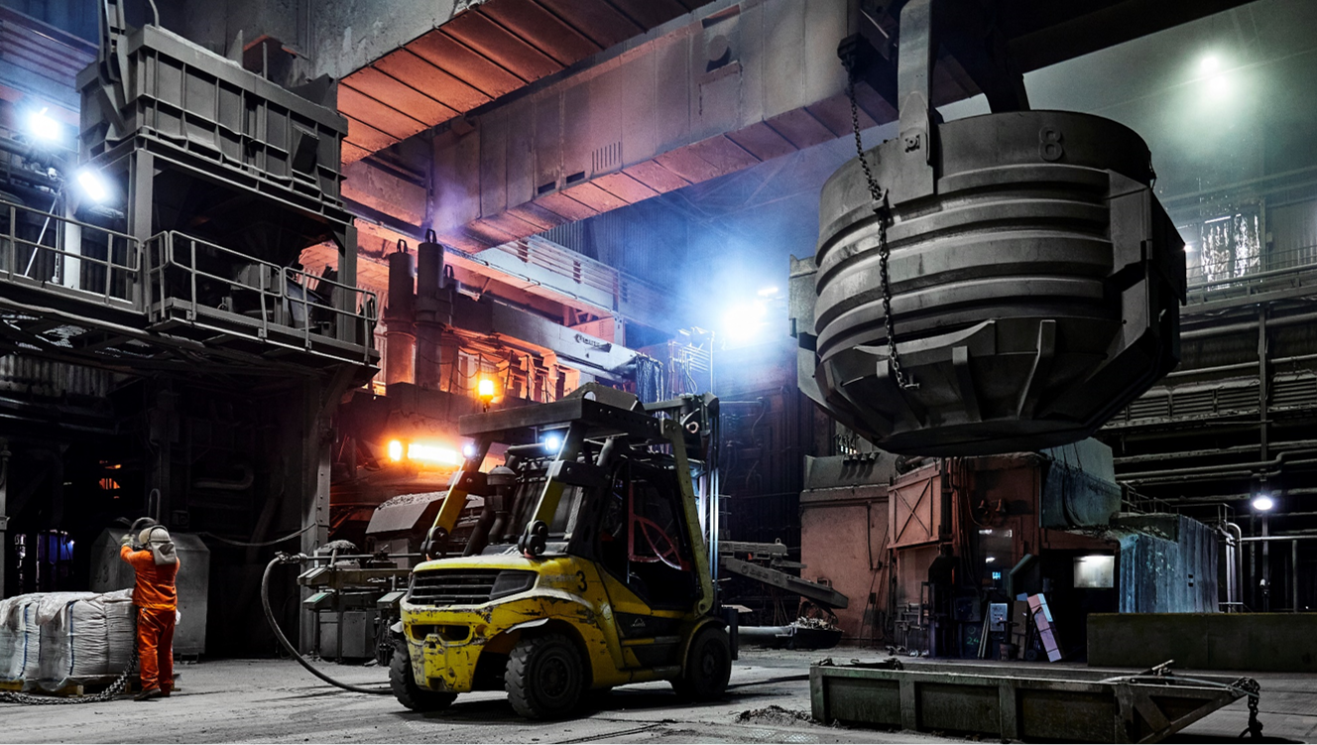
BCT as part of ​Badische Stahlwerke​​
A world-leading electric steel mill.
Supplies all of Europe with high-quality bar stock
and wire rod.
1,300 employees
12 specialized companies
> 2,000,000 tons of annual steel production
Notes:
Before we start, a few words about BCT.
BCT is part of the Badische Stahlwerke Group in Kehl, Germany.
Badische Stahlwerke is one of the largest steel producers in Europe.
They produce around 2 million tons of steel every year.
The group has around 1,300 employees and 12 different companies.

Slide 5


BCT Technology AG – Who We Are​
INDUSTRY FOCUS
Mechanical Engineering, Electronics
Siemens Digital Industries
Software Partner
Sales and
Development Partner
Software Solutions for the Manufacturing Industry
Consulting – Sales – Implementation
35+
100+
Years of
experience in
Digital
Transformation
BCT employees serve over 600 customers worldwide
Complementary
BCT Software Portfolio
Development of
Add-On Software
Notes:
BCT is one of the largest partners of Siemens Digital Industries Software.
We sell and implement Siemens software, and we support companies on their digital journey.
Our main focus is on mechanical and electronics engineering.
We also develop and sell our own software solutions.
We have over 35 years of experience and more than 100 employees, and we support over 600 customers worldwide.

Slide 6
BCT Technology AG
Founded in 1991
Headquarters: Willstätt (Germany) + Branches
Siemens PLM Partner since 1994
Platinum Channel Sales & Platinum
Software & Technology
Close collaboration with Siemens PLM
Smart Expert Partner
NX, Teamcenter, Polarion, …
Extensive expertise in Siemens software products
Add-on BCT Software Portfolio
Product development driven by customer needs
Long-Established
BCT Software is part of the Siemens ecosystem and is sold and supported by Siemens worldwide
Global customer base
BCT software is used by customers from various sectors around the world
Notes:
PW

Slide 7

Drawing2CAD
AI-powered creation of 3D models from technical 2D drawings
Notes:
Now let's move on to the challenge: Drawing2CAD. Generating 3D models from a drawing.

Slide 8

Description
Many older technical drawings are available only as PDFs or scans.
If the part needs to be modified or reused, the 3D model must be manually reconstructed.
Time-consuming
Manual reconstruction ties up valuable design resources
Manual data entry errors
Geometries and dimensions must be transferred manually
Notes:
First of all, why did we decide to take on this challenge? Many companies only have old 2D drawings available as scans or PDFs. Or they receive only 2D drawings from suppliers but need the 3D model to make changes. The solution used so far has been reconstruction. This is very time-consuming and can lead to errors due to manual data transfer.

Slide 9
The Challenge
Develop your prototype
Automatically analyse 2D drawings (e.g. using a Vision Language Model)
Detect contours, dimensions, holes, geometric features and notes
Generate a 3D Model from the extracted data (e.g. using CAD automation tools)
Flag missing information
Notes:
The challenge now is to develop a prototype. First the 2D drawing must be analyzed automatically. The next step is to identify contours, dimensions, holes, geometric features, and notes—in other words, all the necessary information on the drawing. A 3D model should then be generated from this data. It is very important to flag any missing information so that the designer can review and correct it.

Slide 10
Information Provided
PDFs of 2D drawings as input
3D STEP models to compare the results (useful for defining the data schema)
There are no requirements regarding whether or which CAD system should be used
Notes:
Of course, we’ll provide you with many 2D PDF drawings as input, from which a 3D model is to be generated. To go along with the 2D drawings, there’s also a finished 3D model so you can compare the results with the data. We have no requirements regarding which CAD system you use—or even whether you use one at all.

Slide 11
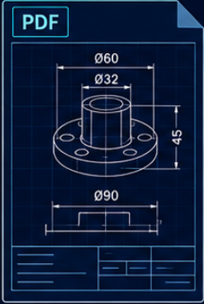
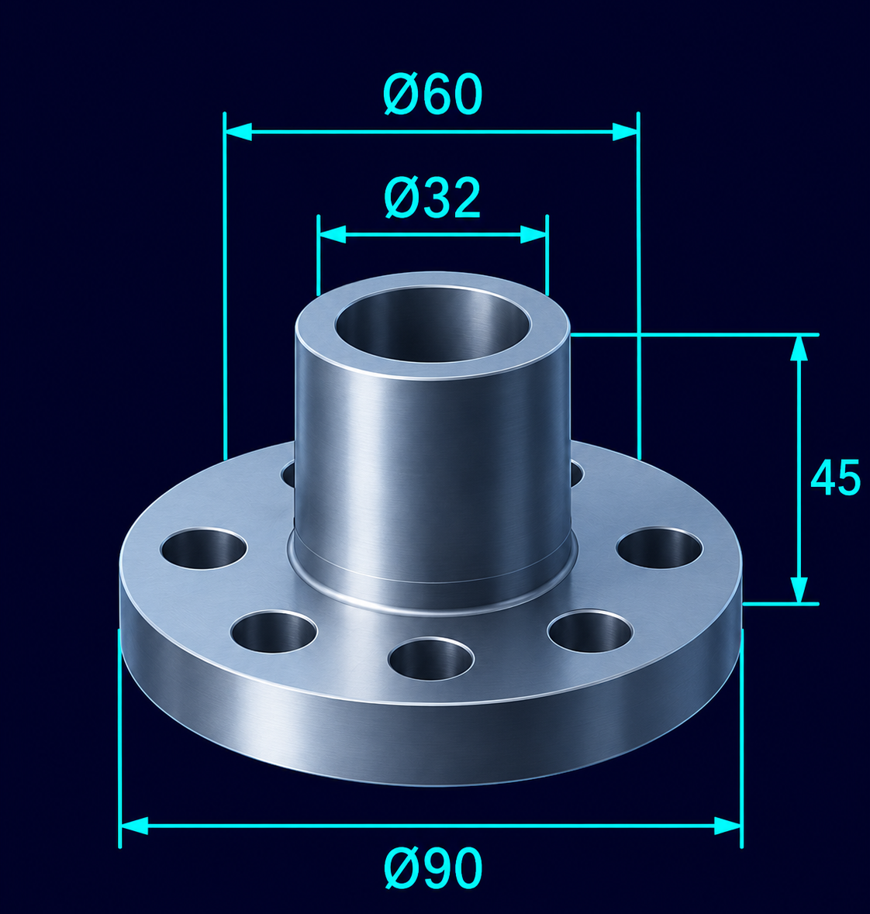
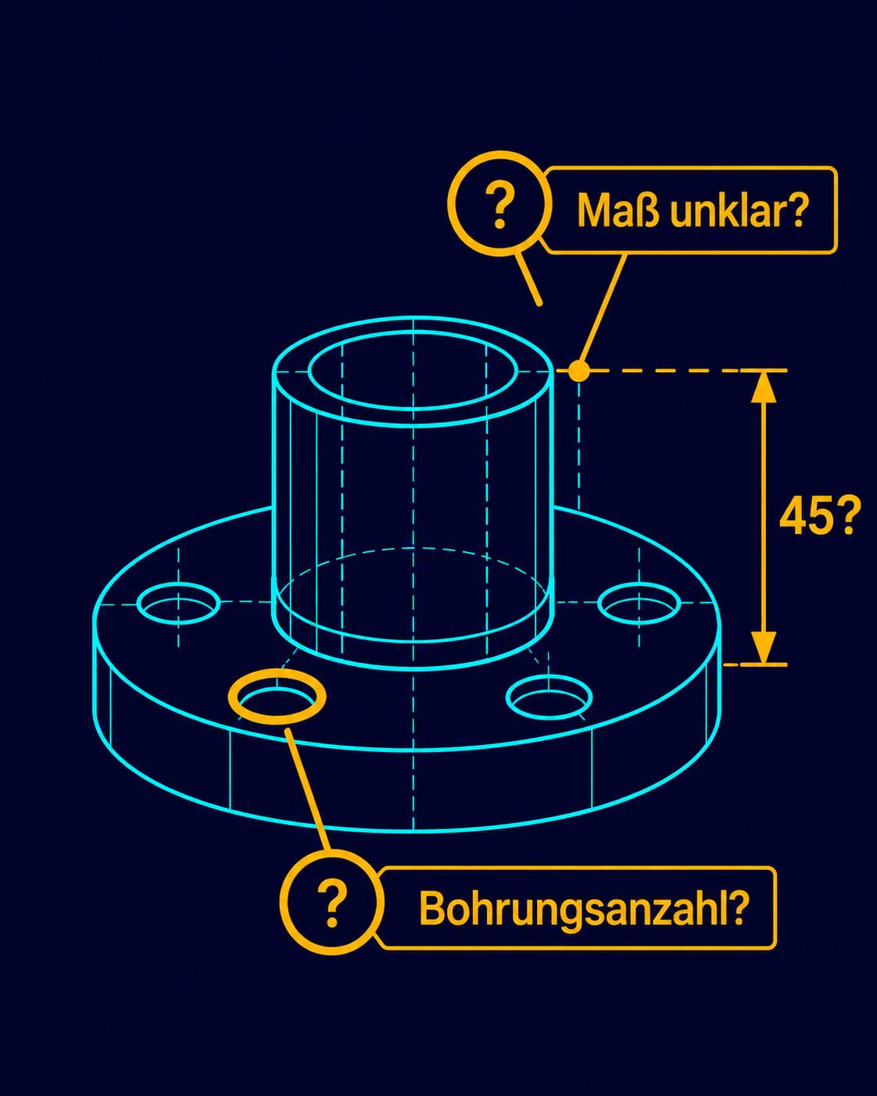
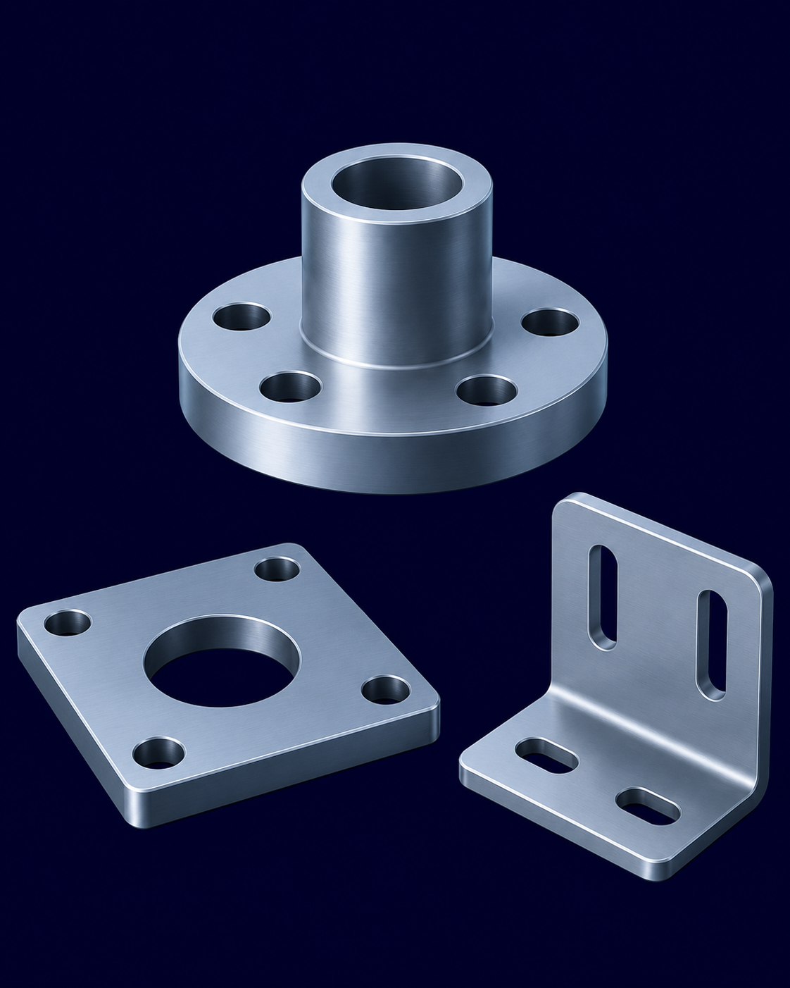
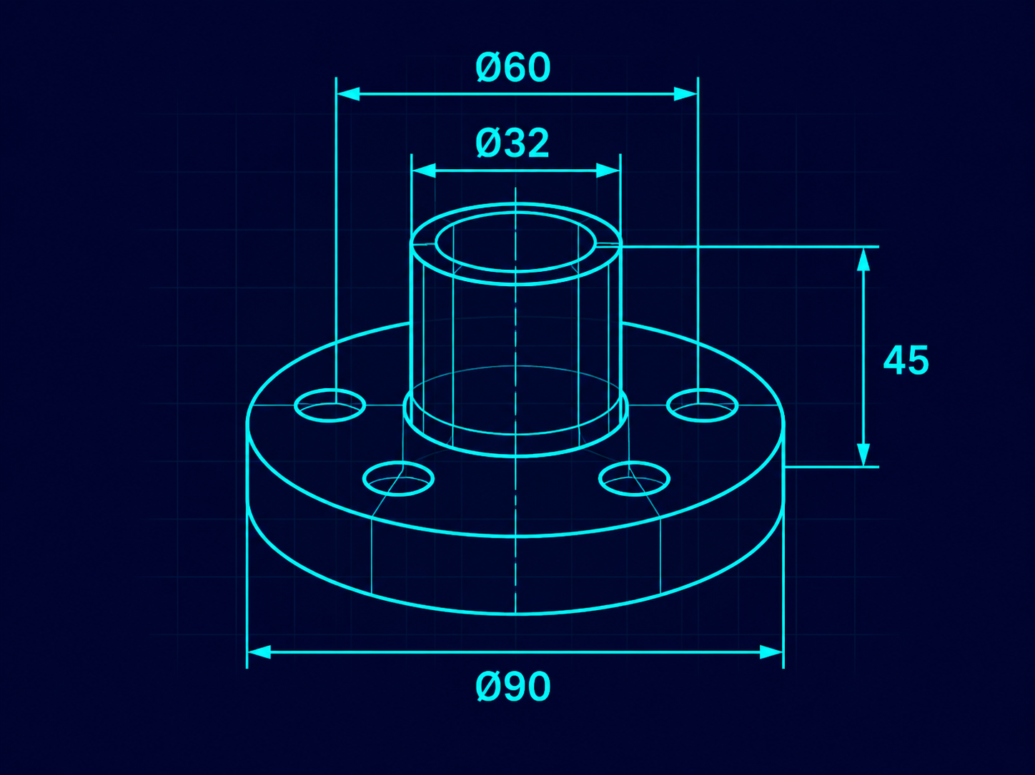

Milestones
2D drawing
upload
and analyze automatically
Recognize contours, holes, dimensions, geometric features, notes
Create a solidbody 3D model
Mark unclear information with PMIs or colors
Demonstration using real sample data
1
2
3
4
5
Hackathon Goal:
Working Prototype
Notes:
We've summarized the challenge again as milestones. First, a 2D drawing is uploaded and analyzed. All information in the drawing must be interpreted correctly. A 3D model—for example, in STEP format—must then be derived from it. Unclear information should be highlighted using colors, PMIs, or other methods. The goal is then to derive accurate 3D models from the sample data.

Slide 12

Extension for Fast Teams
Preparing the Generated Data for Manufacturing:
We use the analyzed data and the 3D model
In addition to the nominal dimensions on the 2D drawing or PMIs, we also extract the tolerances
Analysis of asymmetrical tolerances
Transfer the relevant tolerances to the center
Check whether the 3D model complies with all dimensions and tolerances
If you're interested, please feel free to contact us.
Jan will provide sample data.
Notes:
If a team completes the challenge very quickly, we have an additional task that can be carried out. This involves preparing the 3D model for manufacturing. For this, models designed with center tolerances are required. Therefore, in addition to the nominal dimensions, the tolerances must also be extracted, and the model’s results must be compared with all dimensions and tolerances.

